Slide 1
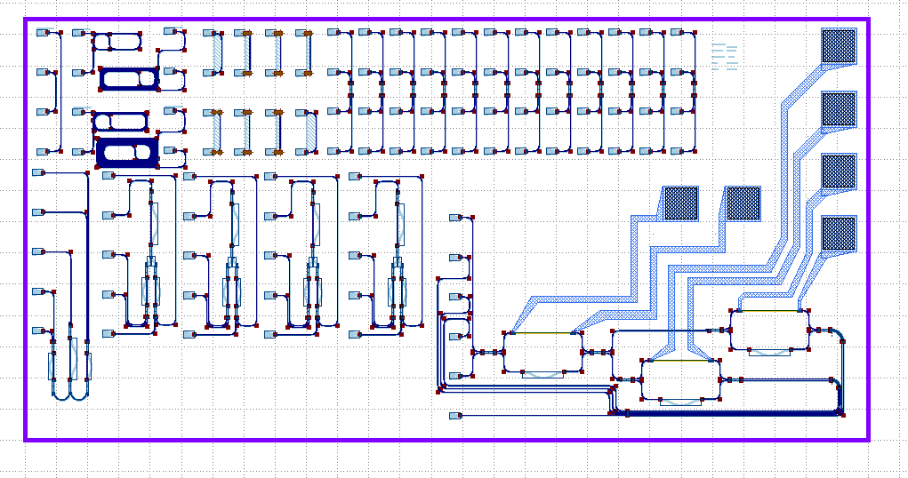
Hamish Design V2

Slide 2
Length Test
R_bend Test
Directional Coupler Testers
LoopBack
MZI Testers
MZI with heaters

Slide 3
Goals
ANT SiN:
ANT SiO2:
Design testable elements towards a 4-channel wavelength-division demultiplexer.

Slide 4
Components
Waveguide: 400nm tall x 450nm wide, 25um bend radius.
Grating coupler: Universal GC PCell from SiN Library at 810nm.
Directional Coupler: From Beta library Pcell.
Heater: From SiN Library.
Delay: SiN Library bump PCell.

Slide 5
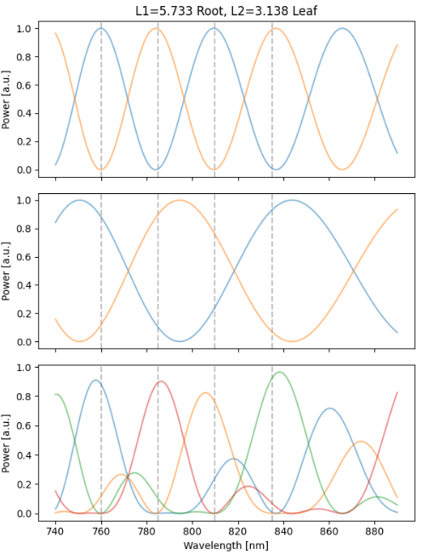
MZI Design
Simplified, one-stage cascaded MZI lattice filter.
Root stage does narrow FSR splitting of even and odd channels.
Leaf stage does wide FSR splitting of low and high channels.

Slide 6
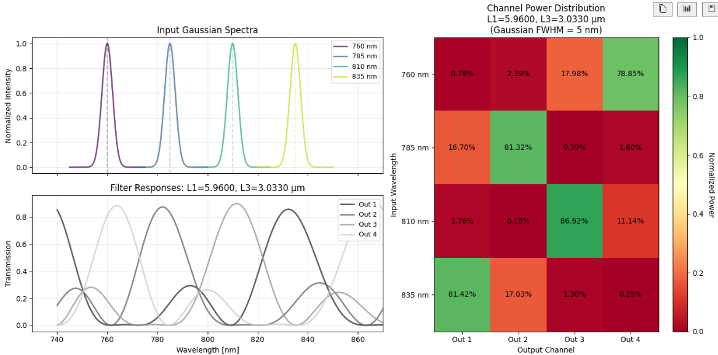
MZI Simulation

Slide 7
MZI Parameters
All directional couplers optimised for 50/50 splitting at 810 (k=1/2).
Delay lengths chosen for channel spacing ~25nm.
This sets FSR and therefore delay lengths L.
L_root =
L_leaf1 =
L_leaf2 =
The goal is to try a few longer and a few shorter designs.

Slide 8
Parameter Sweep – Delay Lengths
200um
500um
1000um
2000um
4000um
8000um

Slide 9
Parameter Sweep – Radius of Curvature
25um
20um
15um
14um
13um
12um
11um
25um

Slide 10
Parameter Sweep – Directional Coupler
Gap [um] | Length [um]
200 | 8
200 | 9
200 | 9.5
200 | 10.101
200 | 10.5
200 | 11
200 | 12
200 | 11.16
200 | 20.202
150 | 10.101
250 | 10.101

